Slide 1
PROBABILITY & STATISTICS

Slide 2
Evaluation Strategy
Must attend more than 80% of contact hours
Evaluating
  03 Progress tests: → 30%
  02 Assignments: → 20%
  01 computer project: → 15%
  Final Exam (FE): → 35%
Pass: Every on-going assessment component > 0
  and Final Exam score ≥ 4 (of 10)
  and Final Result ≥ 5
  Retake only the Final Exam when not passed

Slide 3

Materials
Notes:
the importance of basic elementary functions, limits and continuity

Slide 4
Course description
Chapter 1: The Roles of Statistics in Engineering
Chapter 2: Probability
Chapter 3: Discrete Random Variables and Probability
Distribution
Chapter 4: Continuous Random Variables and
Probability
Chapter 6: Descriptive Statistics
Chapter 7: Point Estimation of Parameters
Chapter 8: Statistical Intervals for a Single Sample
Chapter 9: Test of Hypotheses for a Single Sample
Chapter 10: Statistical Inference for Two Samples
Chapter 11: Simple Linear Regression and Correlation

Slide 5
Chapter 1: THE ROLES OF STATISTICS
IN ENGINEERING
Chapter outline
1.1 The Engineering Method and Statistical Thinking.
1.2 Collecting Engineering Data.
1.3 Mechanistic and Empirical Models.
1.4 Probability and Probability Models.

Slide 6
Objectives
The role that statistics
Making engineering decisions
Enumerative and analytical studies
Methods of data collection
The advantages of designed experiments
Mechanistic models vs empirical models
Why probability models ?

Slide 7
Descriptive Statistics
Involves
- Collecting data
- Organizing or summarizing data.
- Presenting data
Purpose
- Describe the situation.

Slide 8
Inferential Statistics
Involves
- Estimation
- Hypothesis testing.
Purpose
- Draw conclusions
- Inferrences
- About population
- Characteristics

Slide 9
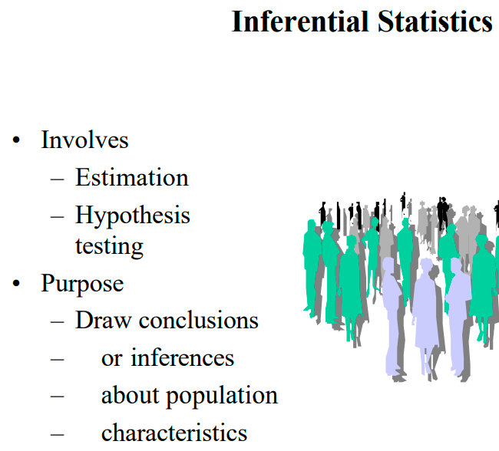


Slide 10
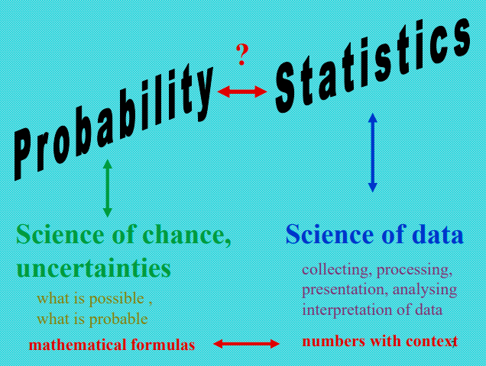

Slide 11
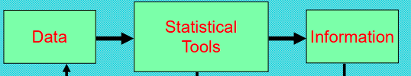

Slide 12
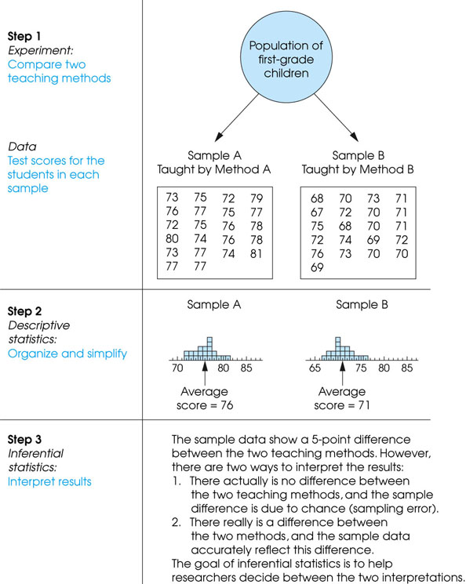
Notes:
Figure 1.3
The role of statistics in experimental research.

Slide 13
Statistics in Engineering
Problems of an engineer
  Refining existing products
  Designing new products or processes

Slide 14
Statistics in Engineering
The field of Statistics deals with the collection, presentation, analysis, and use of data to
  Make decisions
  Solve problems
  Design products and processes

Slide 15
1-1 Statistics in Engineering
Statistical techniques are useful for describing and understanding variability.
By variability, we mean successive observations of a system or phenomenon do not produce exactly the same result.
Statistics gives us a framework for describing this variability and for learning about potential sources of variability.
Notes:
Phenomenon: hiện tượng

Slide 16
1-1 Statistics in Engineering
Engineering Example
An engineer is designing a nylon connector to be used in an automotive engine application. The engineer is considering establishing the design specification on wall thickness at 3/32 inch but is somewhat uncertain about the effect of this decision on the connector pull-off force. If the pull-off force is too low, the connector may fail when it is installed in an engine. Eight prototype units are produced and their pull-off forces measured (in pounds): 12.6, 12.9, 13.4, 12.3, 13.6, 13.5, 12.6, 13.1.

Slide 17
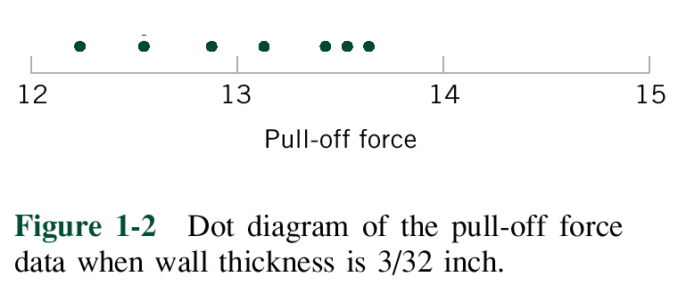
1-1 Statistics in Engineering
Engineering Example
The dot diagram is a very useful plot for displaying a small body of data - say up to about 20 observations.
This plot allows us to see easily two features of the data; the location, or the middle, and the scatter or variability.

Slide 18
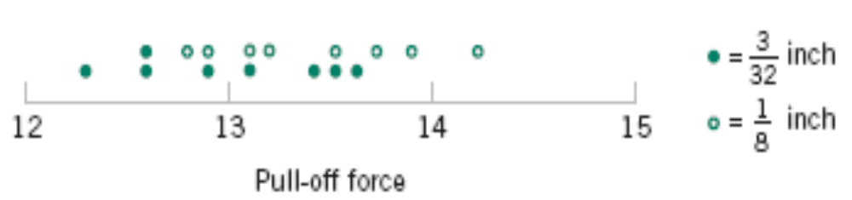
1-1 Statistics in Engineering
Engineering Example
The engineer considers an alternate design and eight prototypes are built and pull-off force measured.
The dot diagram can be used to compare two sets of data
Figure 1-3 Dot diagram of pull-off force for two wall thicknesses.

Slide 19
1-1 Statistics in Engineering
Engineering Example
Since pull-off force varies or exhibits variability, it is a random variable.
A random variable, X, can be model by
X = μ + ε
where μ is a constant and ε a random disturbance.

Slide 20
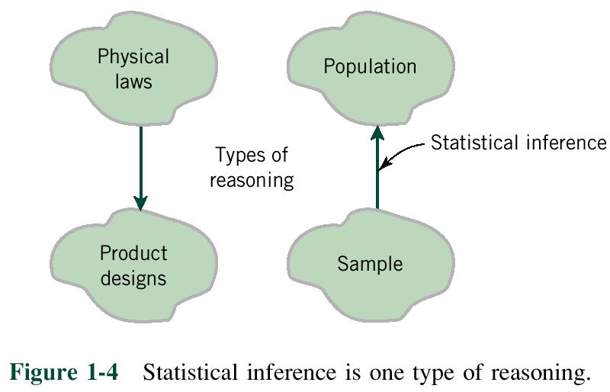
1-1 Statistics in Engineering
Notes:
Inference: su suy ra, ket luan
Reasoning: suy luan, lap luan

Slide 21
1-2 Collecting Engineering Data
Three basic methods for collecting data:
  A retrospective study using historical data
  An observational study
  A designed experiment

Slide 22
1-2 Collecting Engineering Data
  A retrospective study using historical data
  would use either all or a sample of the historical process data archived over some period of time.

Slide 23
1-2 Collecting Engineering Data
  An observational study: the engineer observes the process or population, disturbing it
Notes:
Disturb: lam nhieu loan

Slide 24
1-2 Collecting Engineering Data
  A designed experiment: the engineer makes deliberate in the controlable variables of the system, observes the resulting system output data

Slide 25
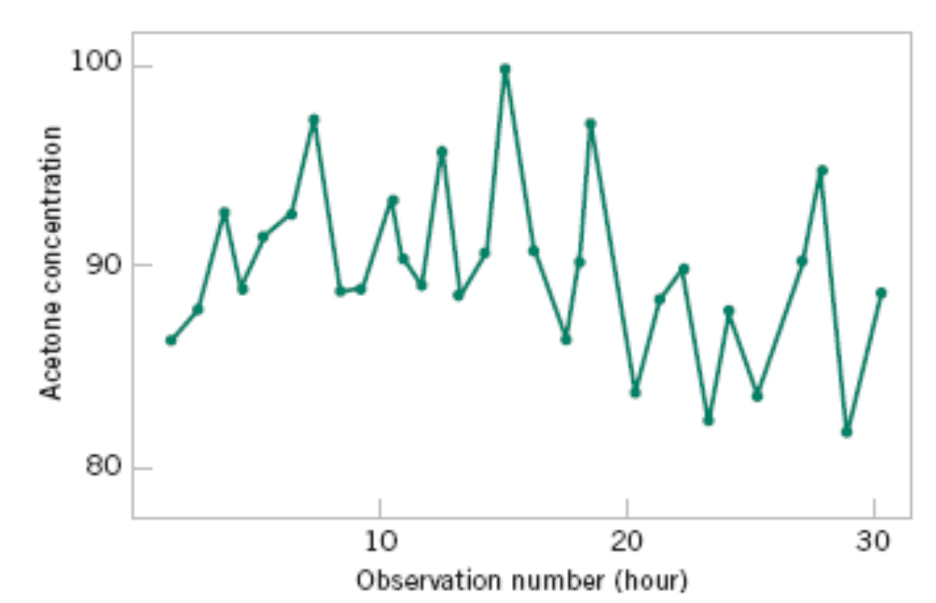
1-2.5 Observing Processes Over Time
Figure 1-9 A time series plot of concentration provides more information than a dot diagram.

Slide 26
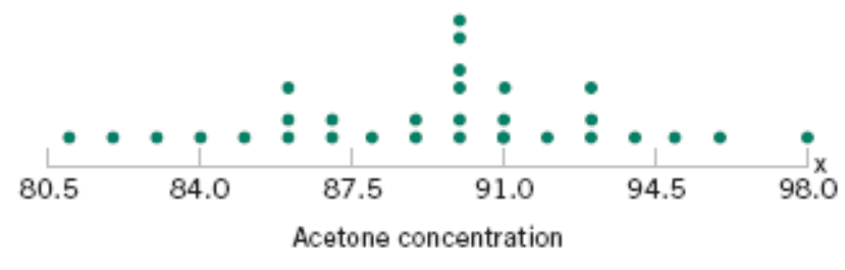
1-2 Observing Processes Over Time
Whenever data are collected over time it is important to plot the data over time. Phenomena that might affect the system or process often become more visible in a time-oriented plot
and the concept of stability can be better judged.
Figure 1-8 The dot diagram illustrates variation but does not identify the problem.

Slide 27
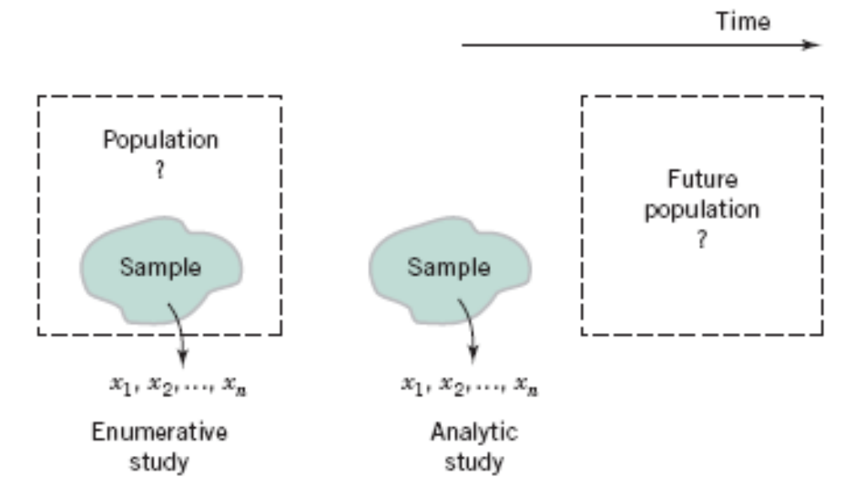
1-2 Observing Processes Over Time
Figure 1-14 Enumerative versus analytic study.

Slide 28
1-3 Mechanistic and Empirical Models
A mechanistic model is built from our underlying knowledge of the basic physical mechanism that relates several variables.
Example: Ohm’s Law
Current = voltage/resistance
I = E/R
I = E/R + ε

Slide 29
1-3 Mechanistic and Empirical Models
An empirical model is built from our engineering and scientific knowledge of the phenomenon, but is not directly developed from our theoretical or first-principles understanding of the underlying mechanism.

Slide 30
1-3 Mechanistic and Empirical Models
Example
Suppose we are interested in the number average molecular weight (M_{n}) of a polymer. Now we know that M_{n} is related to the viscosity of the material (V), and it also depends on the amount of catalyst (C) and the temperature (T ) in the polymerization reactor when the material is manufactured. The relationship between M_{n} and these variables is
M_{n} = f(V,C,T)
say, where the form of the function f is unknown.
where the β’s are unknown parameters.
Notes:
Viscosity: tính dẻo; catalyst: chất xúc tác.

Slide 31
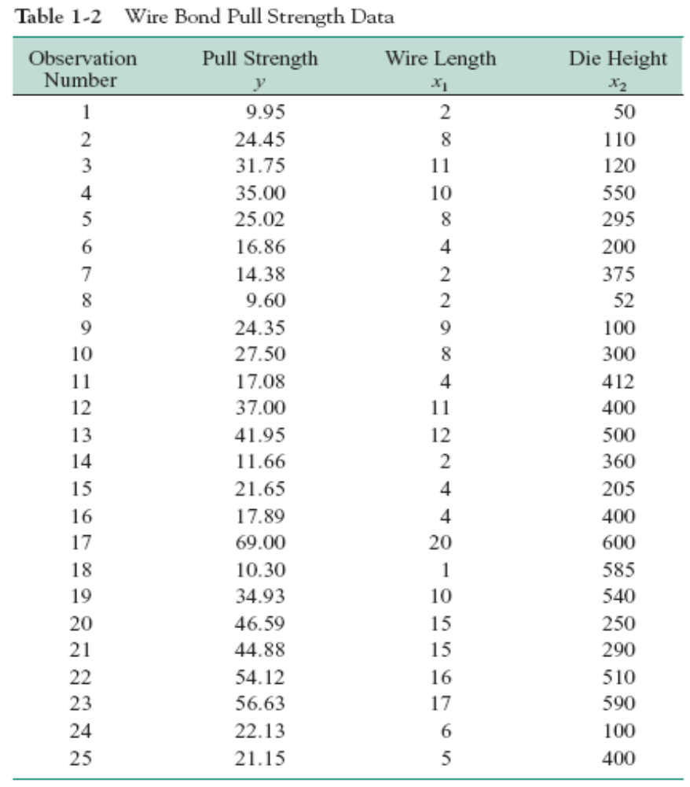

Slide 32
1-3 Mechanistic and Empirical Models
In general, this type of empirical model is called a regression model.
The estimated regression line is given by

Slide 33
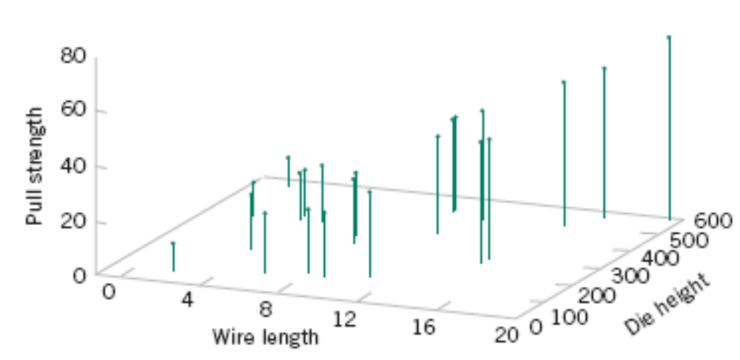
Figure 1-15 Three-dimensional plot of the wire and pull strength data.

Slide 34
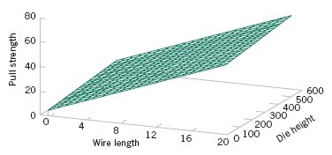
1-4 Probability and Probability Models
Figure 1-16 Plot of the predicted values of pull strength from the empirical model.

Slide 35
1-4 Probability and Probability Models
Probability models help quantify the risks involved in statistical inference, that is, risks involved in decisions made every day.
Probability provides the framework for the study and application of statistics.
Notes:
Quantify: định lượng

Slide 36
